Slide 1
Lecture 4: Linear Regression
Instructor: Xiaobai Liu

Slide 2
Regression: single feature
Housing Price
Price (K$)
300
200
100
500
1000
1500
2000
2500
3000
Size (feet²)
Supervised Learning: trading history available
Regression: predict real-value prices

Slide 3
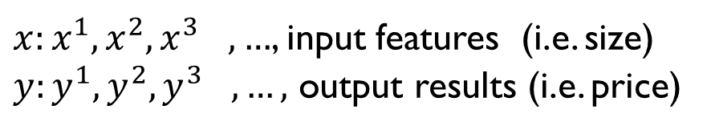
Training Set (92115)
Size (feet²) | Price (K$)
856 | 399.5
1512 | 449
865 | 350
1044 | 345
… | …
Notations
${x:x^{1},x^{2},x^{3}}_{},…$, input features (i.e. size)
${y:y^{1},y^{2},y^{3}}_{},…,$ output results (i.e. price)

Slide 4
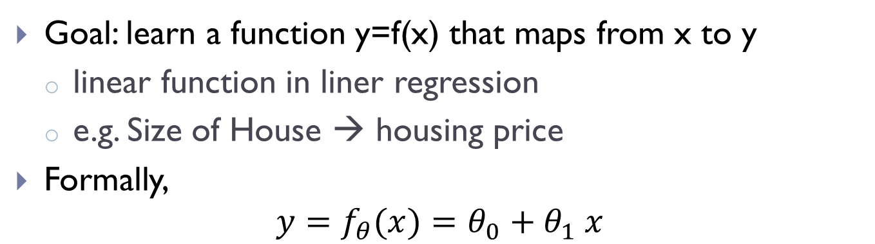
Linear Regression
Goal: learn a function y=f(x) that maps from x to y
linear function in liner regression
e.g. Size of House → housing price
Formally,
$$y=f_{θ}(x)=θ_{0}+θ_{1} x$$
y
x
($θ_{0}$, $θ_{1}$): parameters to learn (intercept and slope)

Slide 5
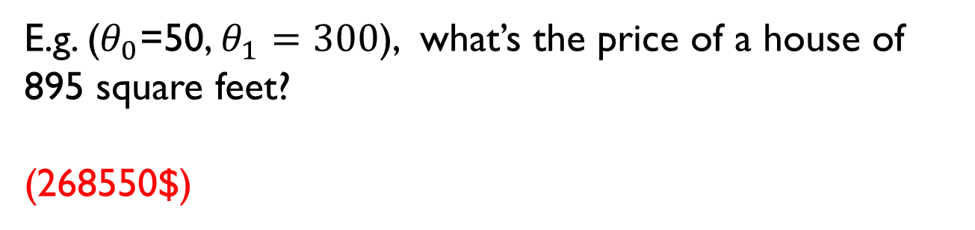

Quiz
$$y=f_{θ}(x)=θ_{0}+θ_{1} x$$
E.g. ($θ_{0}$=50, $θ_{1}=300$), what’s the price of a house of 895 square feet?
(268550$)

Slide 6




Illustration of linear Regression Models
Parameters: ($θ_{0}$, $θ_{1}$)
$$y=0+0.177 x$$
Price (K$)
300
$$y=100+0.11 x$$
$$y=200+0 x$$
200
100
500
1000
1500
2000
2500
3000

Slide 7
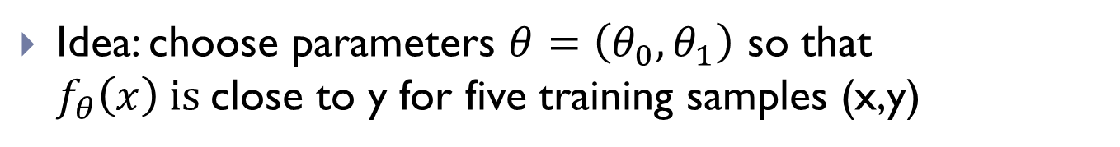
How to learn parameters?
Which one is the best?
Price (K$)
300
200
100
500
1000
1500
2000
2500
3000
Size (feet²)
Idea: choose parameters $θ=\left(θ_{0}, θ_{1}\right)$ so that $f_{θ}\left(x\right) is$close to y for five training samples (x,y)

Slide 8
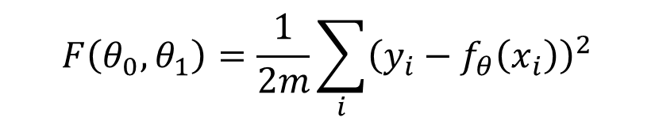
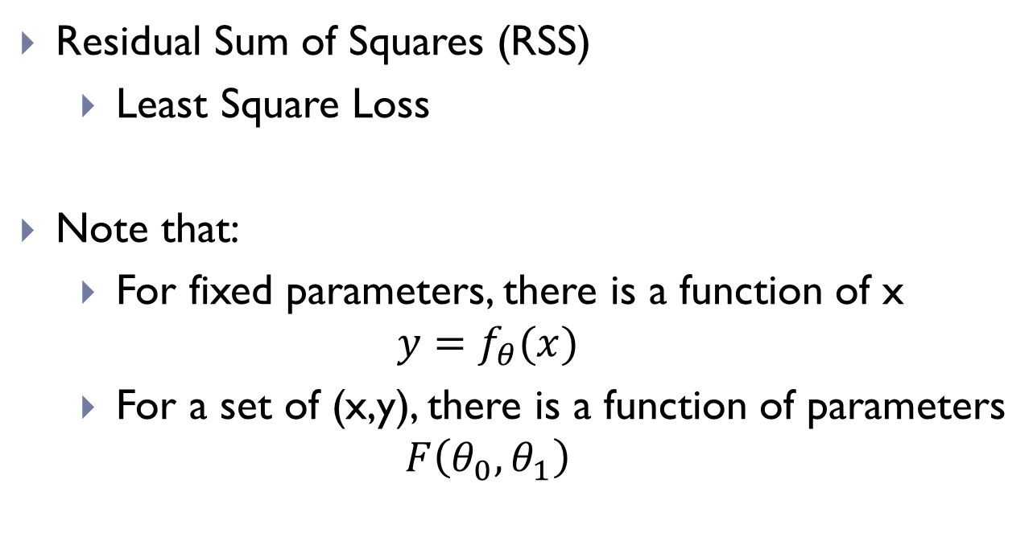
Cost function
Choose parameters so that f(x) is close to y for all the five training samples (x, y)
$$F\left(θ_{0},θ_{1}\right)=\frac{1}{2m}\sum_{i}{{\left(y_{i}−f_{θ}\left(x_{i}\right)\right)}^{2}}$$
Minimize
Residual Sum of Squares (RSS)
Least Square Loss
Note that:
For fixed parameters, there is a function of x ${y=f}_{θ}(x)$
For a set of (x,y), there is a function of parameters $F\left(θ_{0},θ_{1}\right)$

Slide 9
Residual of Cost Function
Price (K$)
300
200
100
500
1000
1500
2000
2500
3000
Size (feet²)
Indicate if training procedure has converged;
Used to estimate confidences of outputs

Slide 10
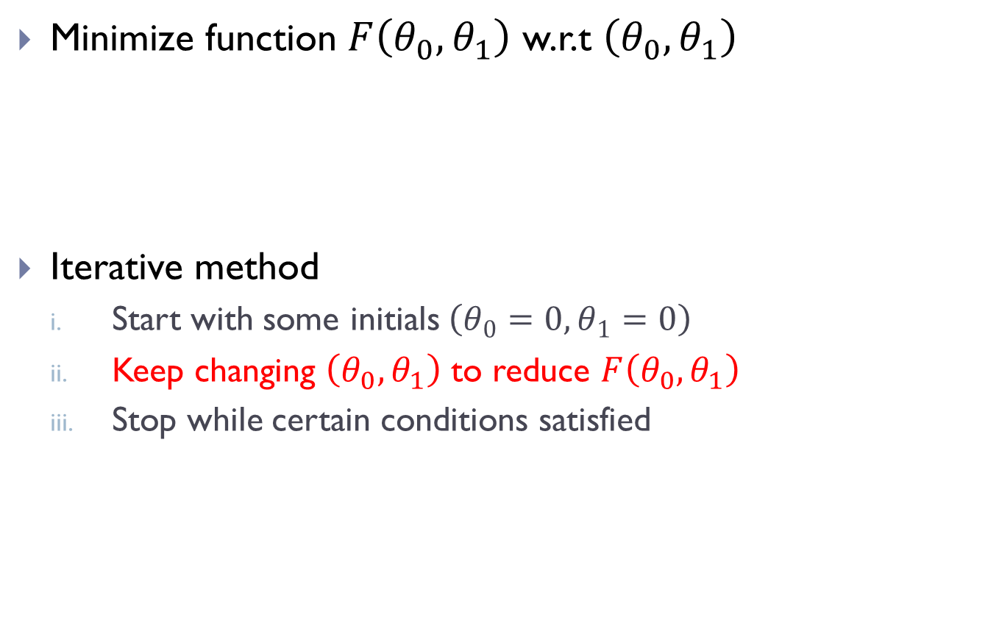
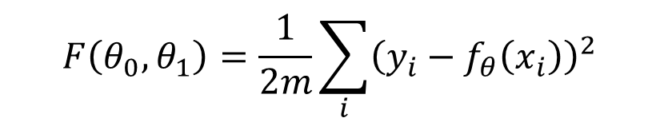
How to optimize cost function
Minimize function $F\left(θ_{0},θ_{1}\right)$ w.r.t $\left(θ_{0},θ_{1}\right)$
Iterative method
Start with some initials $\left(θ_{0}=0,θ_{1}=0\right)$
Keep changing $\left(θ_{0},θ_{1}\right)$ to reduce $F\left(θ_{0},θ_{1}\right)$
Stop while certain conditions satisfied
$$F\left(θ_{0},θ_{1}\right)=\frac{1}{2m}\sum_{i}{{\left(y_{i}−f_{θ}\left(x_{i}\right)\right)}^{2}}$$

Slide 11
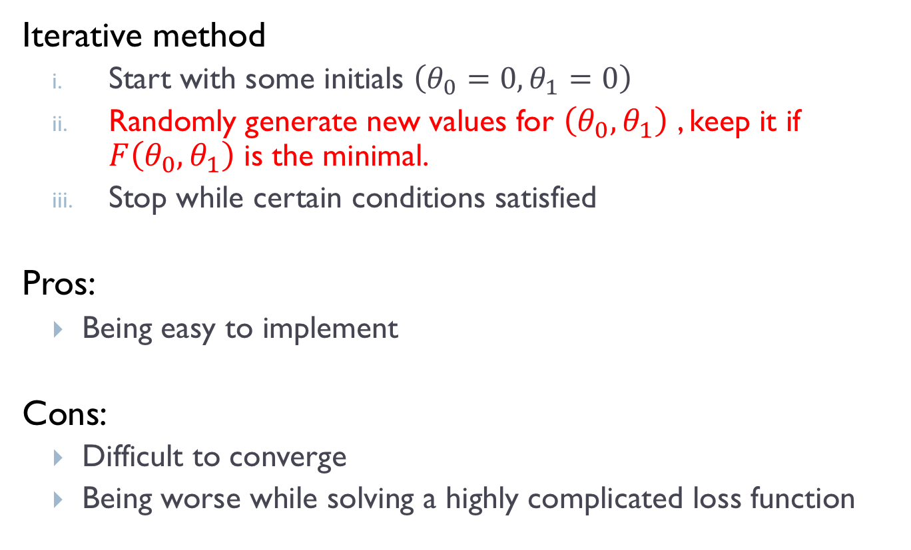
A Computer-based solution
Iterative method
Start with some initials $\left(θ_{0}=0,θ_{1}=0\right)$
Randomly generate new values for $\left(θ_{0},θ_{1}\right)$ , keep it if $F\left(θ_{0},θ_{1}\right)$ is the minimal.
Stop while certain conditions satisfied
Pros:
Being easy to implement
Cons:
Difficult to converge
Being worse while solving a highly complicated loss function

Slide 12
A smart solution

Slide 13
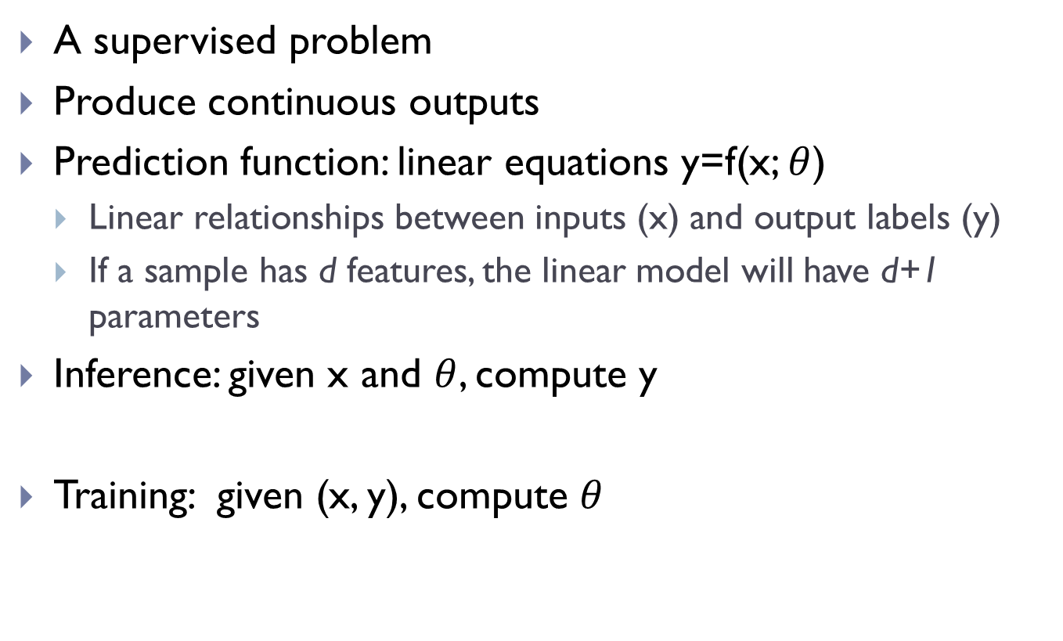
Recap: linear regression
A supervised problem
Produce continuous outputs
Prediction function: linear equations y=f(x; $θ$)
Linear relationships between inputs (x) and output labels (y)
If a sample has d features, the linear model will have d+1 parameters
Inference: given x and $θ$, compute y
Training: given (x, y), compute $θ$

Slide 14
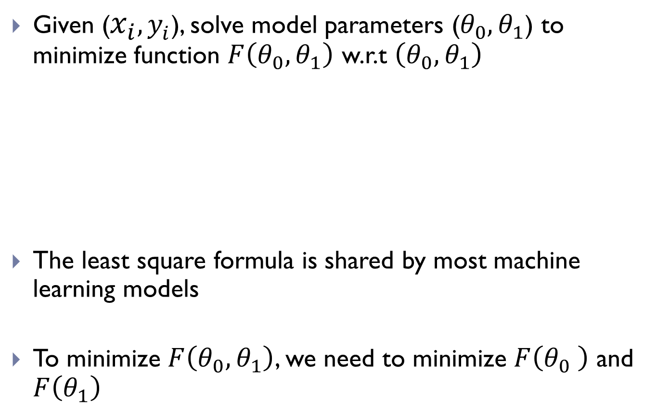
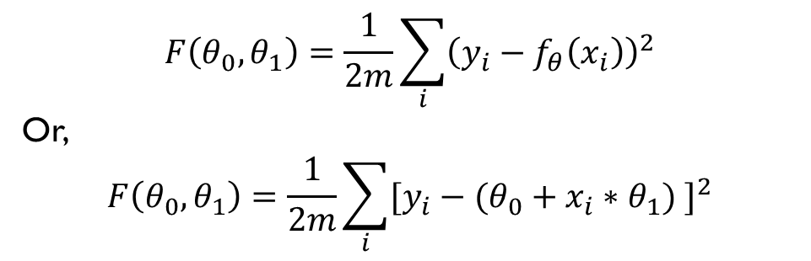
Recap: Cost Function
Given ($x_{i}{, y}_{i}$), solve model parameters ($θ_{0},θ_{1}$) to minimize function $F\left(θ_{0},θ_{1}\right)$ w.r.t $\left(θ_{0},θ_{1}\right)$
The least square formula is shared by most machine learning models
To minimize $F\left(θ_{0},θ_{1}\right)$, we need to minimize $F\left(θ_{0} \right)$ and $F\left(θ_{1}\right)$
$$F\left(θ_{0},θ_{1}\right)=\frac{1}{2m}\sum_{i}{{\left(y_{i}−f_{θ}\left(x_{i}\right)\right)}^{2}}$$
Or,
$$F\left(θ_{0},θ_{1}\right)=\frac{1}{2m}\sum_{i}{{[y_{i}−(θ_{0}+x_{i}∗θ_{1}) ]}^{2}}$$

Slide 15

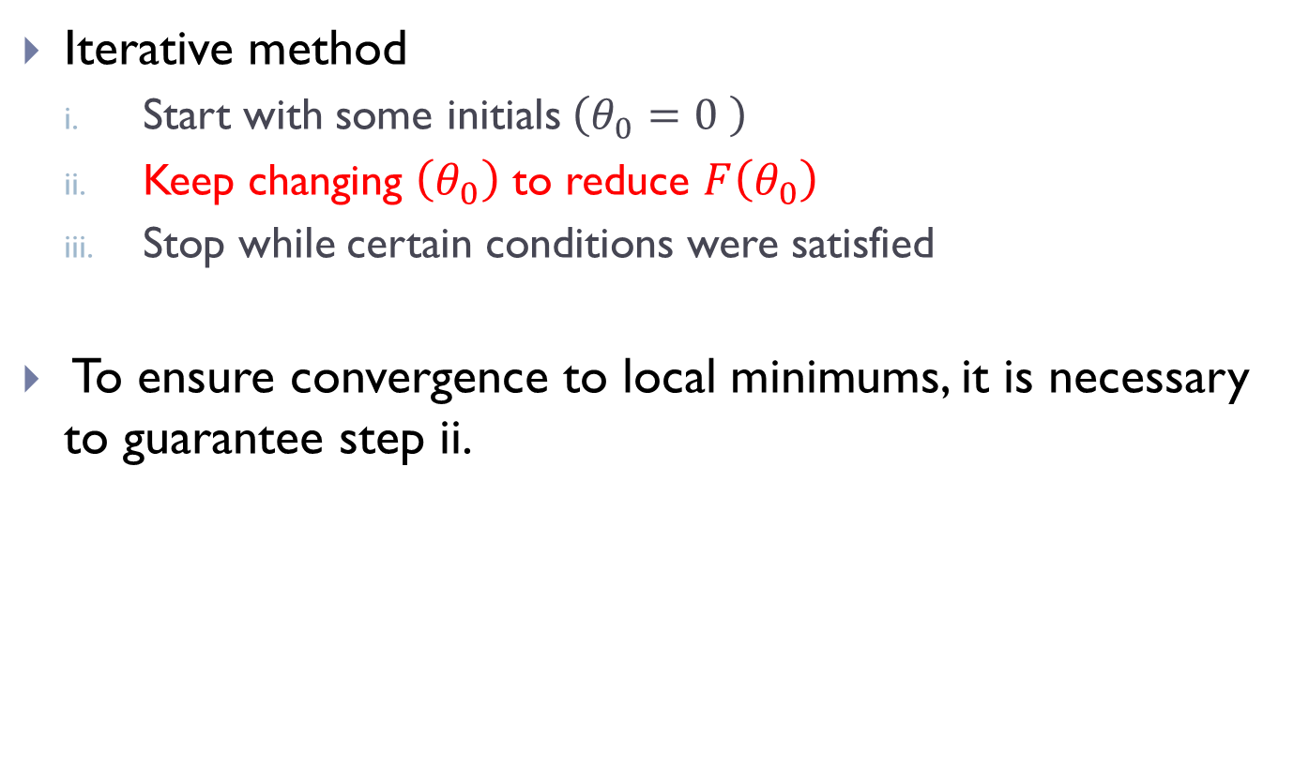
Ho to minimize cost functions F($θ$)?
Iterative method
Start with some initials $\left(θ_{0}=0 \right)$
Keep changing $\left(θ_{0}\right)$ to reduce $F\left(θ_{0}\right)$
Stop while certain conditions were satisfied
To ensure convergence to local minimums, it is necessary to guarantee step ii.

Slide 16
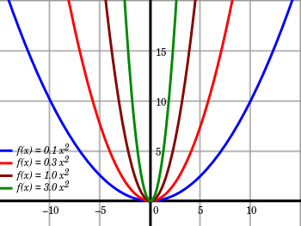
Review: Quadratic Functions
Zero, one, or two real roots.
One extreme, called the vertex.
No inflection points.
Line symmetry through the vertex. (Axis of symmetry.)
Rises or falls at both ends.
Can be constructed from three non-colinear points or three pieces of information.
One fundamental shape.
Roots are solvable by radicals. (Quadratic Formula.)

Slide 17


Review: Quadratic Functions
$$θ_{0}$$

Slide 18


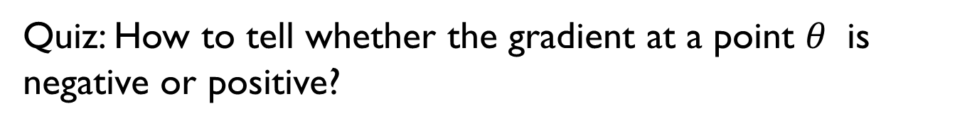
Review: gradient at a point
$$F=func (θ)$$
$$Δ_{F}$$
$$Δ_{θ}$$
Quiz: How to tell whether the gradient at a point $θ$ is negative or positive?

Slide 19
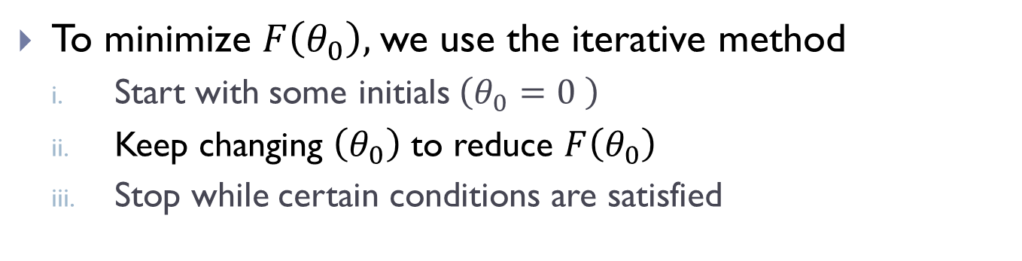
Iterative methods
To minimize $F\left(θ_{0}\right),$we use the iterative method
Start with some initials $\left(θ_{0}=0 \right)$
Keep changing $\left(θ_{0}\right)$ to reduce $F\left(θ_{0}\right)$
Stop while certain conditions are satisfied
minimum

Slide 20



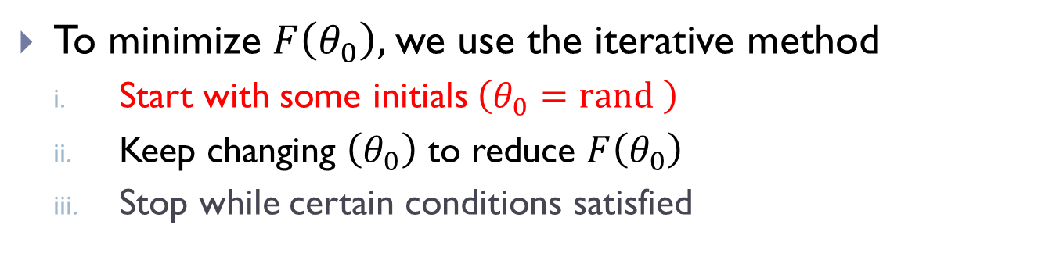
Iterative methods
To minimize $F\left(θ_{0}\right),$we use the iterative method
Start with some initials $\left(θ_{0}=rand \right)$
Keep changing $\left(θ_{0}\right)$ to reduce $F\left(θ_{0}\right)$
Stop while certain conditions satisfied
$$θ_{0}$$
$$θ_{0}$$
Question: how to change $θ_{0}$?

Slide 21
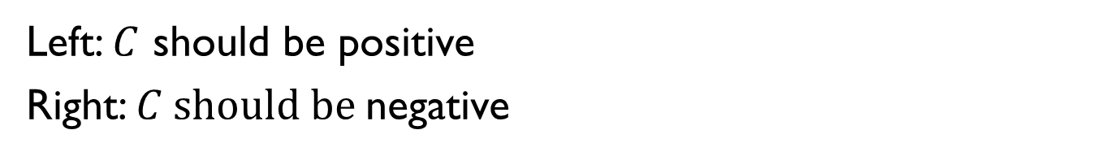


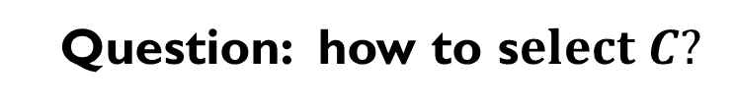
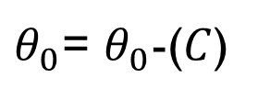
Iterative methods
$θ_{0}$= $θ_{0}$-($C$)
$$θ_{0}$$
$$θ_{0}$$
Left: $C$ should be positive
Right: $C should be$negative
Question: how to s$elect C?$
Notes:
Gradient based methods?

Slide 22

Solution: gradient based method
To solve $θ_{0}$
Initialize $\left(θ_{0} \right)$
Repeat until convergence
$θ_{0}=θ_{0}−α\frac{∂F\left(θ_{0}\right)}{∂θ_{0}}$
To solve $θ_{1}$
Initialize $\left(θ_{1} \right)$
Repeat until convergence
$θ_{1}=θ_{1}−α\frac{∂F\left(θ_{1}\right)}{∂θ_{1}}$

Slide 23
Review: First-order Derivative
Y=ax+b
Y=-ax^2+b
Y=-log x
Y=exp(-ax)
Y=ax+by+c
Notes:
Derivatives:
A
-2ax
-1/x
-aExp(-ax)
a or b

Slide 24
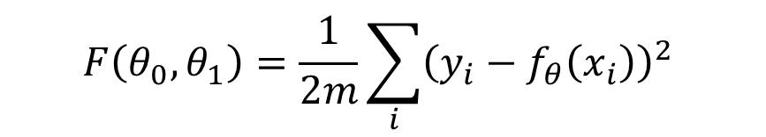


Method : Gradient Descent
$$F\left(θ_{0},θ_{1}\right)=\frac{1}{2m}\sum_{i}{{\left(y_{i}−f_{θ}\left(x_{i}\right)\right)}^{2} }$$
Initialize $\left(θ_{0},θ_{1}\right)$
Repeat until convergence
$θ_{j}=θ_{j}−α\frac{∂F}{∂θ_{j}}, j=0, 1$
$$θ_{0}$$

Slide 25
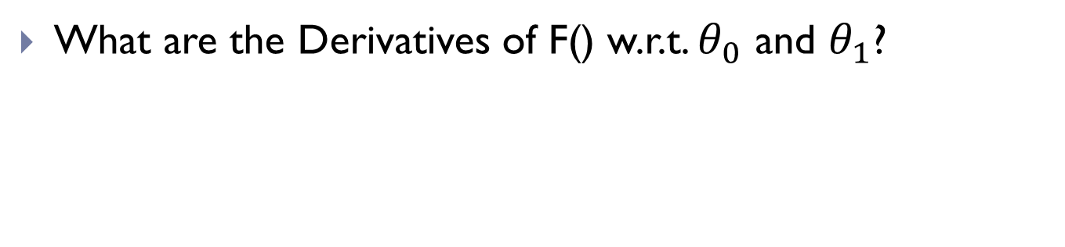
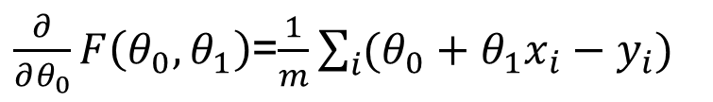
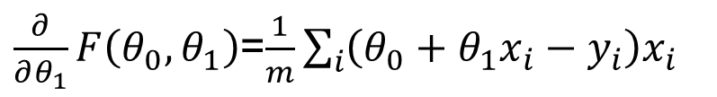

Gradient Descent for RSS
Cost Function
$$F\left(θ_{0},θ_{1}\right)=\frac{1}{2m}\sum_{i}{{\left(y_{i}−f_{θ}\left(x_{i}\right)\right)}^{2} }$$
$$=\frac{1}{2m}\sum_{i}{{\left(θ_{0}+θ_{1}x_{i}−y_{i}\right)}^{2}}$$
What are the Derivatives of F() w.r.t. $θ_{0}$ and $θ_{1}$?
$\frac{∂}{∂θ_{0}}F\left(θ_{0},θ_{1}\right)$=$\frac{1}{m}\sum_{i}{({θ_{0}+θ_{1}x_{i}−y}_{i})}$
$\frac{∂}{∂θ_{1}}F\left(θ_{0},θ_{1}\right)$=$\frac{1}{m}\sum_{i}{\left({θ_{0}+θ_{1}x_{i}−y}_{i}\right)x_{i}}$

Slide 26
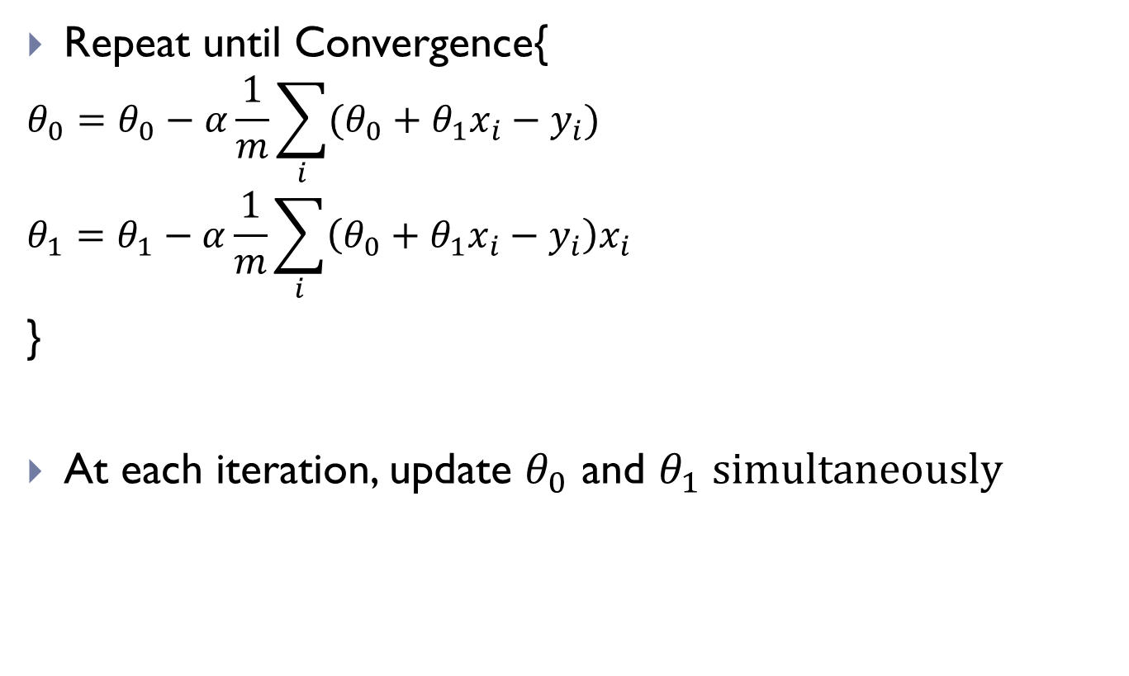
Gradient Descent for RSS
Repeat until Convergence{
$$θ_{0}=θ_{0}−α\frac{1}{m}\sum_{i}{({θ_{0}+θ_{1}x_{i}−y}_{i})} \\ θ_{1}=θ_{1}−α\frac{1}{m}\sum_{i}{\left({θ_{0}+θ_{1}x_{i}−y}_{i}\right)x_{i}}$$
}
At each iteration, update $θ_{0}$ and $θ_{1} simultaneously$

Slide 27

Understanding GD
$$θ_{1}=θ_{1}−α\frac{1}{m}\sum_{i}{\left({θ_{0}+θ_{1}x_{i}−y}_{i}\right)x_{i}}$$
Prediction
True Label
Feature

Slide 28


Understanding GD
Learning Rate $α$ should be empirically set
Too small, slow convergence
Too large, fail to converge or diverge
fixed $α$ over time
Adaptive steps
$$θ_{1}$$

Slide 29
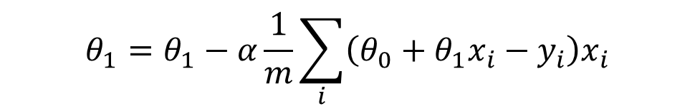
Understanding GD
Batch Gradient Descent
At each step , access all the training samples
$$θ_{1}=θ_{1}−α\frac{1}{m}\sum_{i}{\left({θ_{0}+θ_{1}x_{i}−y}_{i}\right)x_{i}}$$

Slide 30
How to improve convergence
Access more training samples
Learning rate
Smaller or bigger
Closed form solution
Normal equation

Slide 31
Variants of GD
Access all training samples at every iteration
Access a portion of training samples at iteration

Slide 32
Recap
Linear Regression
Cost Function: Residual Sum of Square
Gradient Descent Method

Slide 33
Linear Regression: Multiple Features

Slide 34
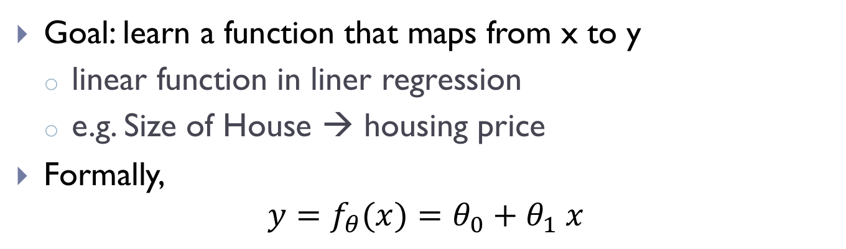
Regression: multiple feature
Example: Housing Price
Size | Bedroom | Bathroom | Built year | Stories | Price (K$)
1024 | 3 | 2 | 1978 | 1 | 375
1329 | 3 | 2 | 1992 | 1 | 425
1893 | 4 | 2 | 1980 | 2 | 465
… | … | … | … | … | …
Single feature
$$y=f_{θ}(x)=θ_{0}+θ_{1} x$$
Multiple feature
$y=f_{θ}\left(x\right)=θ_{0}+θ_{1} x^{1}+θ_{2} x^{2}+θ_{3}x^{3}$ +…

Slide 35
Review: Linear Algebra
Matrix/Vector
Addition and Scalar Multiplication
Matrix-vector/matrix-matrix multiplication
A \times B is not equal B times A (no commutative)
A * B *C =A*(B*C)
Identity matrix
Inverse and Transpose

Slide 36
Notations
$$y=f_{θ}\left(x\right)=θ_{0}+θ_{1} x^{1}+θ_{2} x^{2}+θ_{3}x^{3} \text{+…}$$
Let $θ=\left[θ_{0}, θ_{1}, θ_{2},θ_{3}…\right], x=[1, x^{1}, x^{2},x^{3},…]$
then we have
$$y=f_{θ}\left(x\right)=θ^{T}x$$
Let $x_{i}=\left[1, x_{i}^{1},x_{i}^{2},x_{i}^{3}\right]$ represent the i-th training sample, $y_{i}$ semantic label.

Slide 37
Gradient Descent for Multiple Features
Cost Function
$$F\left(θ\right)=\frac{1}{2m}\sum_{i}{{\left(y_{i}−f_{θ}\left(x_{i}\right)\right)}^{2} }$$
= $\frac{1}{2m}{\sum_{i}{\left(y_{i}−θ^{T}x_{i}\right)}}^{2}$
Gradient Descent
Repeat{
}

Slide 38
Gradient Descent for Multiple Features
Gradient Descent
Repeat{
$$θ_{j}=θ_{j}−α \frac{1}{m}\sum_{i}{(θ^{T}x_{i}−y_{i}){x_{j}}^{i} }$$
}
Update $θ_{1},θ_{2},…$simultaneously

Slide 39
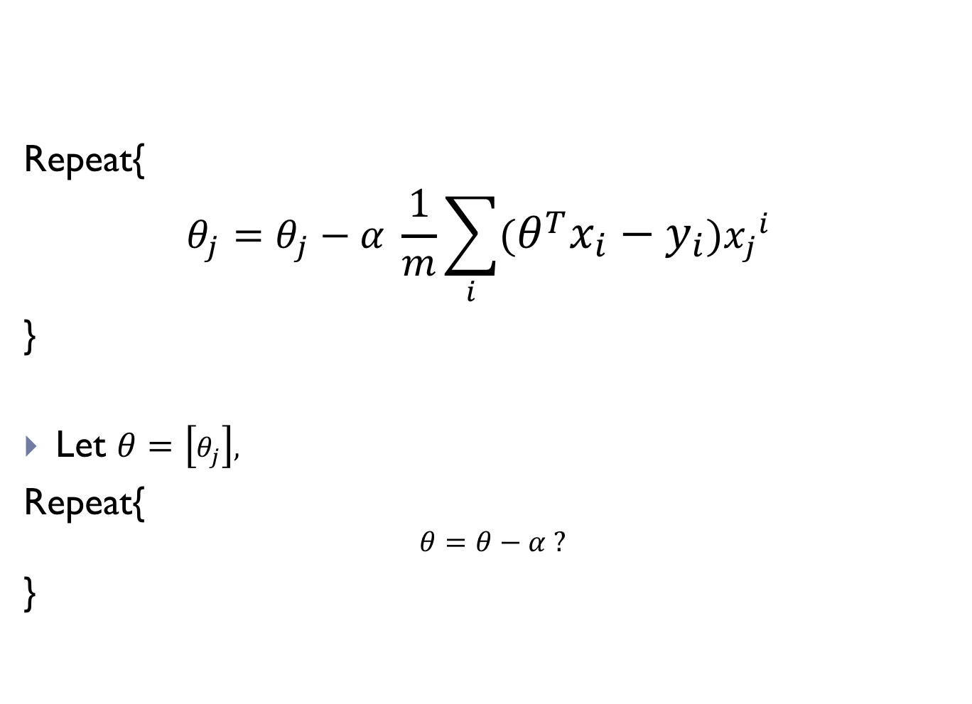
Quiz: how to implement GD using vectors?
Repeat{
$$θ_{j}=θ_{j}−α \frac{1}{m}\sum_{i}{(θ^{T}x_{i}−y_{i}){x_{j}}^{i} }$$
}
Let $θ=\left[θ_{j}\right],$
Repeat{
$$θ=θ−α ?$$
}

Slide 41
LR: practices
Feature Scaling
Mean Normalization
Learning rate
Polynomial Regression
Normal equation
Feature selection
Variants

Slide 42
Practice 1: Feature Scaling
to guarantee features are on a similar scale
E.g. housing price
Size: 100- 1000 square feet
Bed Room: 1..5
normalize features to be -1<x<1

Slide 43

Practice 2: Mean Normalization
Replace $x_{i}$ with $x_{i}−x_{u}$to make features have approximately zero mean

Slide 44
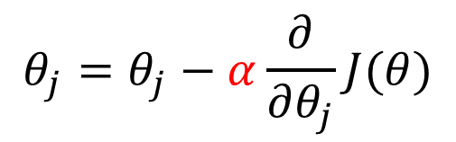

Practice 3: Learning Rate
$$θ_{j}=θ_{j}−α\frac{∂}{∂θ_{j}}J(θ)$$
How to choose learning rate
Too small: slow convergence
Too large: no convergence
F($θ)$
Number of Iterations
To choose learning rate, try 0.001, 0.05, 0.01

Slide 45
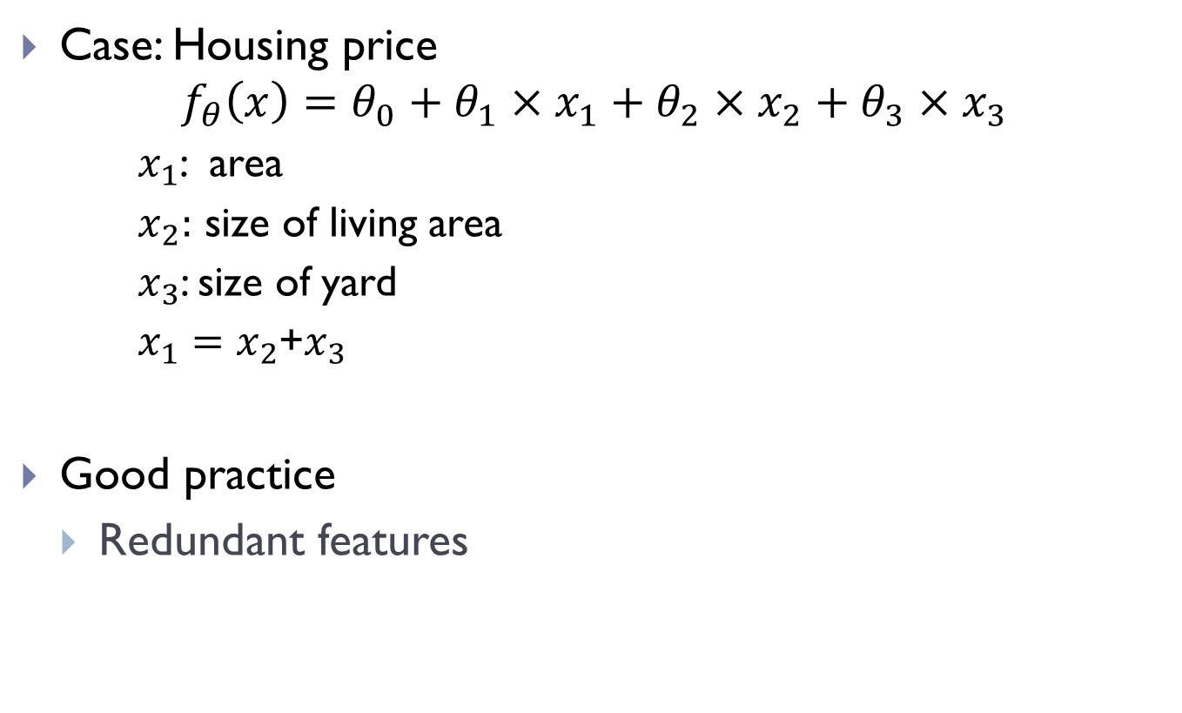
Practice 4: Polynomial Regression
Case: Housing price
$$f_{θ}\left(x\right)=θ_{0}+θ_{1}×x_{1}+θ_{2}×x_{2}+θ_{3}×x_{3}$$
$x_{1}$: area
$x_{2}:$ size of living area
$x_{3}$: size of yard
$x_{1}=x_{2}$+$x_{3}$
Good practice
Redundant features

Slide 46
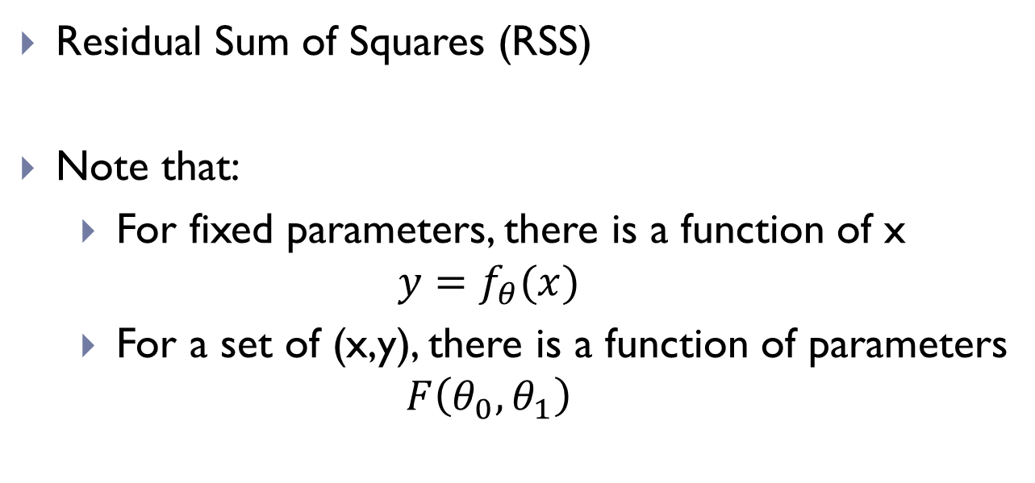
Practice 4: Polynomial Regression
Polynomial regression
$$f_{θ}\left(x\right)=θ_{0}+θ_{1}×area$$
$$+θ_{2}×area^{2}$$
$$+θ_{3}×area^{3}$$
Price (y)
Size(x)

Slide 47
Practice 5: Normal Equation
Iterative method
Normal Equation: solve parameters analytically

Slide 48
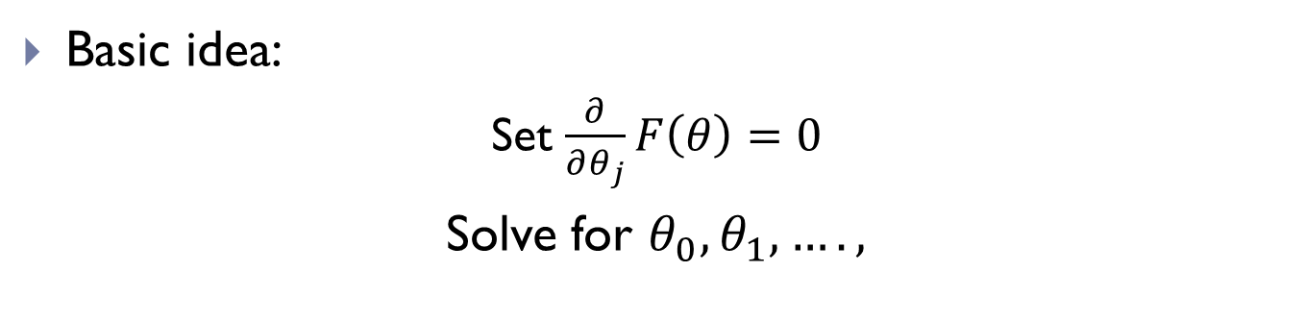
Practice 5: Normal Equation
Basic idea:
Set $\frac{∂}{∂θ_{j}}F\left(θ\right)=0$
Solve for $θ_{0}, θ_{1},….,$
Example: least square loss
$$F\left(θ\right)=\frac{1}{2m}{\sum_{i}{\left(y_{i}−θ^{T}x_{i}\right)}}^{2}$$
Let ${y=[y}_{i}]={\left[y_{1},y_{2},y_{3},..,\right]}^{T},∈R^{m×1 } X={\left[{1, x}_{1},x_{2},x_{3},…\right]}^{T}∈R^{m×n }$
$$F\left(θ\right)={\frac{1}{2}\left(y−Xθ\right)}^{2}$$

Slide 49
Practice 5: Normal Equation
$$F\left(θ\right)={\frac{1}{2}\left(y−Xθ\right)}^{2}$$
Solve $θ$ as follows,
$$\frac{\begin{aligned} \\ ∂F\left(θ\right)\end{aligned}}{∂θ}=0$$
$$θ={\left(X^{T}X\right)}^{−1}X^{T}y$$
cowbook

Slide 50
Example 5: Normal equation
Size | Bedroom | Bathroom | Built year | Stories | Price (K$)
1024 | 3 | 2 | 1978 | 1 | 375
1329 | 3 | 2 | 1992 | 1 | 425
1893 | 4 | 2 | 1980 | 2 | 465
… | … | … | … | … | …
1 1024 3 2 1978 1
1 1329 3 2 1992 1
1 1893 4 2 1980 2
…
$$X=$$
375
425
465
…
y$=$

Slide 51
Practice 5: Normal Equation
Normal Equation
No need to choose $α$
No iteration
Need Compute matrix inverse which might be too large
Gradient Descent
Need to choose $α$
Need many iterations
Fit to large-scale problem (i.e. ${10}^{16}$ training samples)

Slide 52

Normal Equation
What if $X^{T}X$ is non-invertible
Too many features
Delete some redundant features
Use Regularization

Slide 53
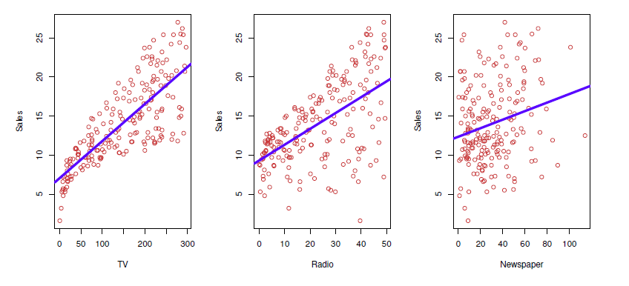
More example: Advertising
To Learn relationships between Advertising Budge and Sales
TV, radio, and Newspaper

Slide 54
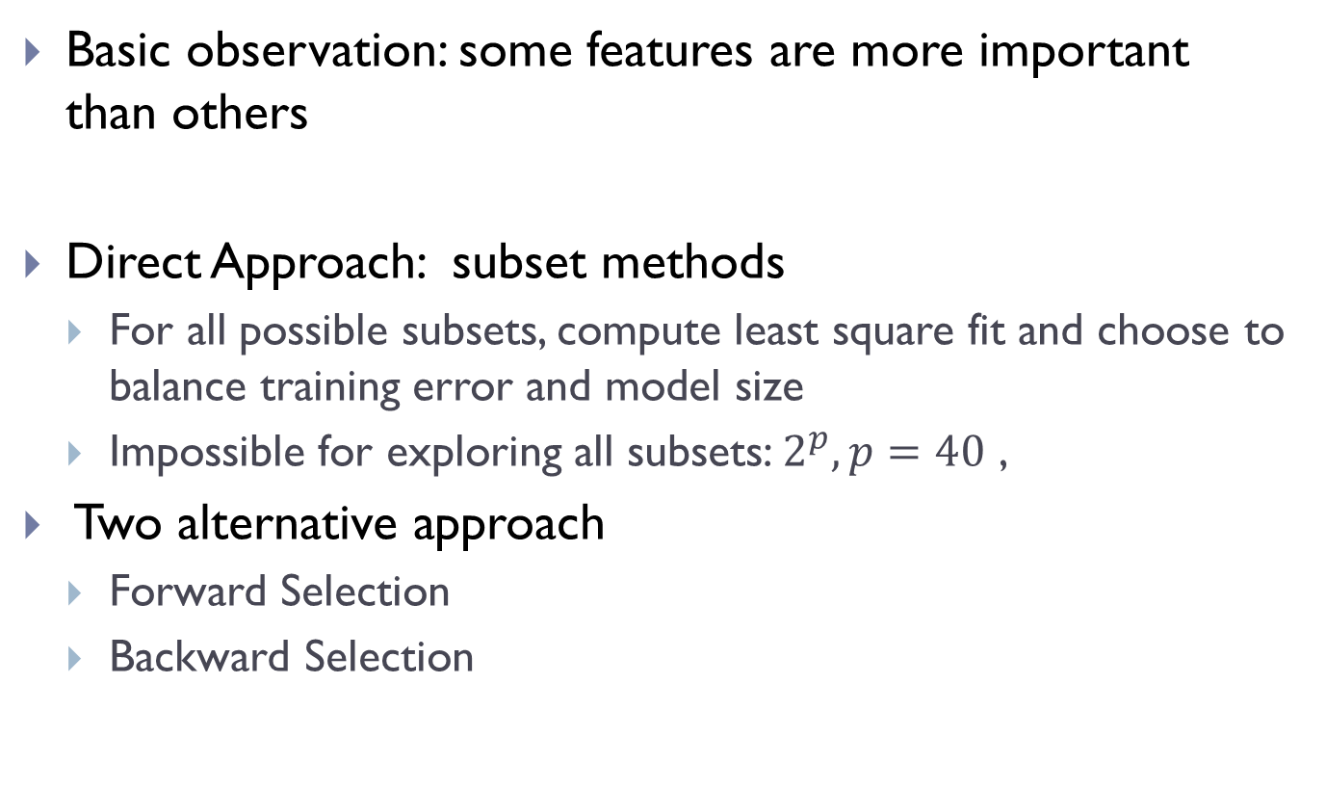
Practice 6: selecting important features
Basic observation: some features are more important than others
Direct Approach: subset methods
For all possible subsets, compute least square fit and choose to balance training error and model size
Impossible for exploring all subsets: $2^{p}, p=40$ ,
Two alternative approach
Forward Selection
Backward Selection

Slide 55
Conti.
Forward selection
Begin with null model – only intercept but not predictors (features)
Train multiple models using a single variable and add to the null model the variable that results in the lowest RSS; (one)
Expand the one-variable model to be two-variable models and keep the one with lowest RSS (two)
Continue until some conditions satisfied

Slide 56
Conti.
Backward approach
Start with all variables in the model (let d denote the number of variables)
Remove one variable from the model to get a (d-1)-variable model; Test all (d-1)-variable models and keep the one with least training error.
Continue the above removal process until a stopping rule is reached.

Slide 57
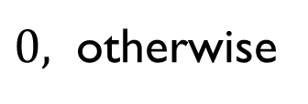

Practice 7: qualitative features
Some predictors/features are not quantitative but are qualitative, taking a discrete set of values
Categorical predictors
Factor variable
E.g. house type, short sale, gender, student, status
Consider a feature, house type:
$1,$ if single family
$$x=$$
$0,$ otherwise

Slide 58

Conti.
Resulting Model is:
$β_{0}+β_{1},$ if single family
$$y=β_{0}+β_{1}x^{1}=$$
$β_{0},$ otherwise
Additional Dummy Variables
$β_{0}+β_{1},$ if single family
$$y=β_{0}+β_{1}x^{1}+β_{2}x^{2}=$$
$β_{0}+β_{2}, otherwise$

Slide 59
Practice: Links to other ML methods
Classification problems: logistic regression
Non-linearity: kernel smoothing, nearest neighbor method
Interactions: tree-based methods bagging, random forests, and boosting
Regularized fitting: ridge regression and lasso

Slide 60
LR: practices
Feature Scaling
Mean Normalization
Learning rate
Polynomial Regression
Normal equation
Feature selection
Variants

